Slide 1
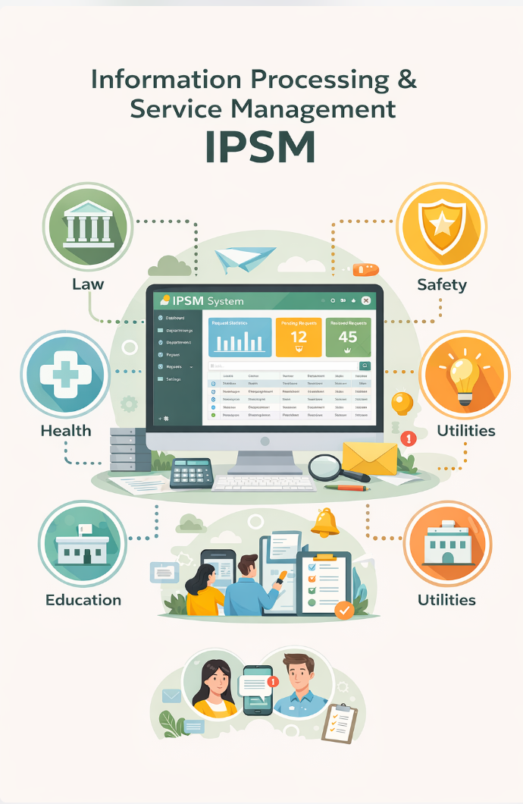
Integrated Integrated Public Service Management System (IPSM)
Team Members:
Zarish Shahzad (B25F0172AI18)
Mehral Qureshi (B25F1030AI202)
Muhammad Somaid Ali (B25F1030AI202)

Slide 2
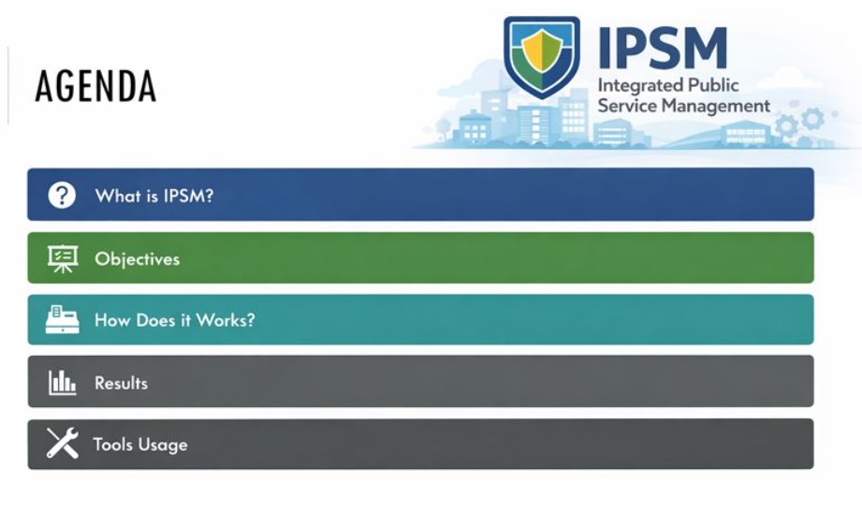

Slide 3
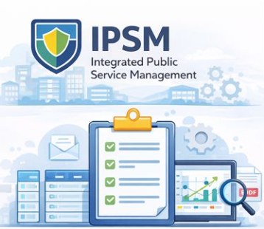
What is IPSM?
The Integrated Public Service Management System (IPSM) is a centralized digital platform designed to manage and analyze multiple public services through a single unified system. Instead of handling education, healthcare, transport, and municipal services separately, IPSM integrates them into one management framework.

Slide 4
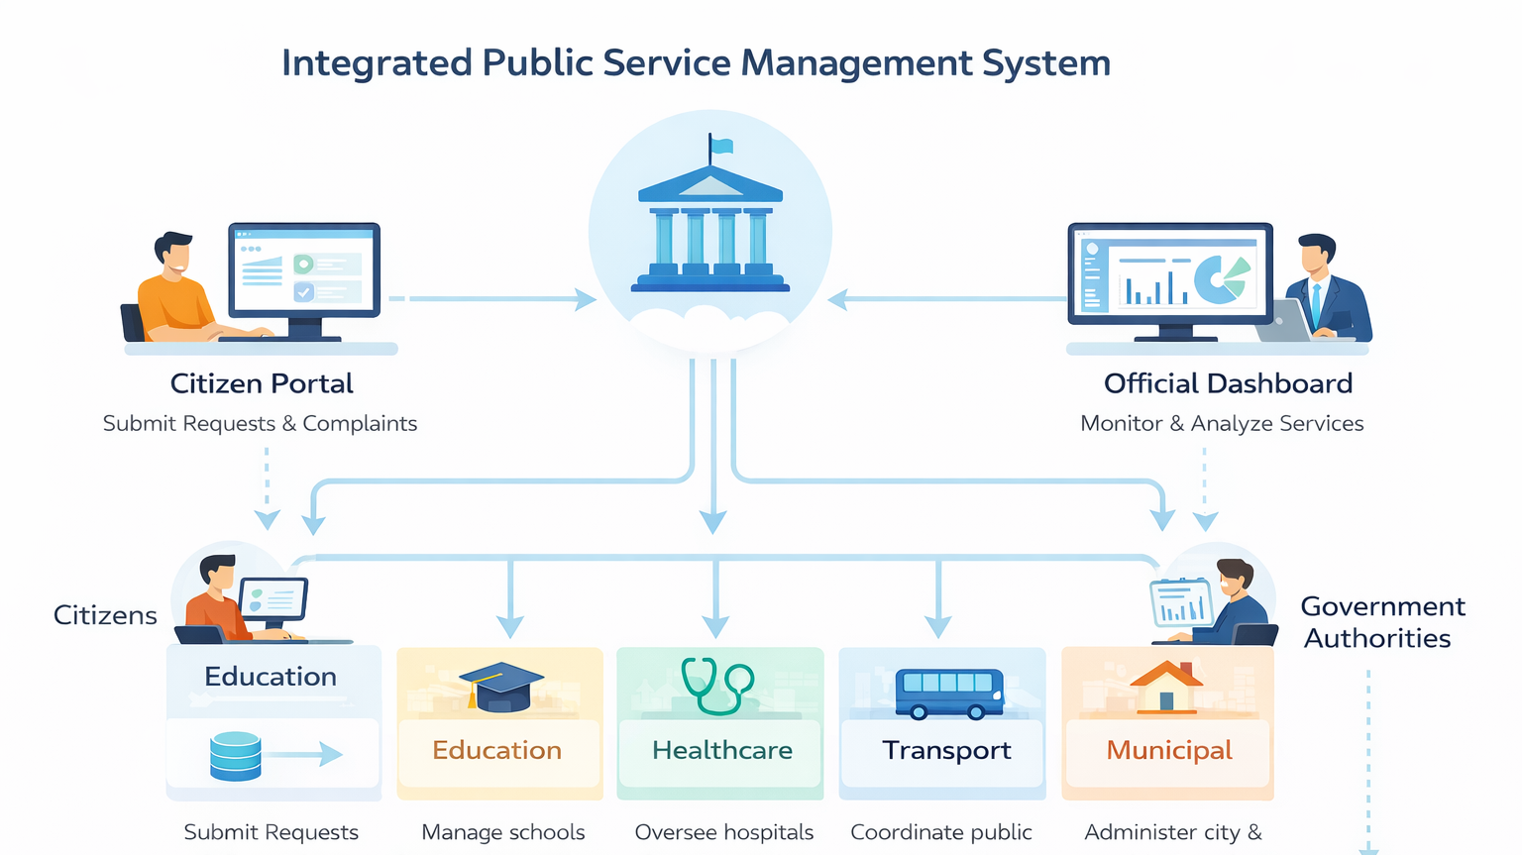

Slide 5

Objectives
To integrate multiple public service departments into one centralized system.
To provide a simple platform for citizens to submit and track service requests.
To store all service-related data in a structured and relational database.
To analyze departmental performance using data analysis tools.
To support authorities in decision-making through reports and visual analysis.
To demonstrate effective integration of multiple ICT tools.

Slide 6
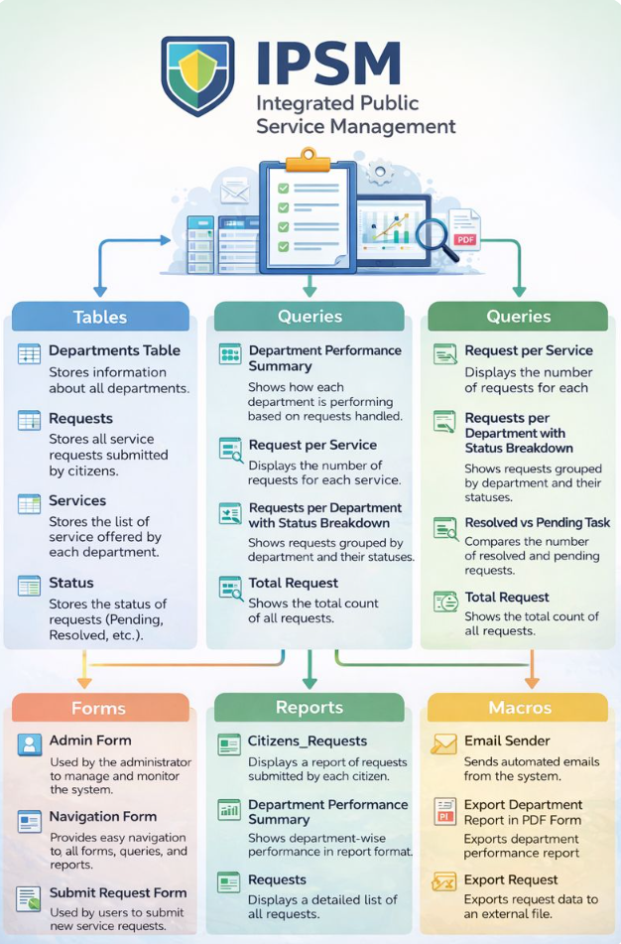

Tools Used: Access for Backend
MS Access is used as our primary database, where we have multiple tables to store our data.
We have tables for each department, requests and their status.
We have also queries for analyzing each departments performances.

Slide 7
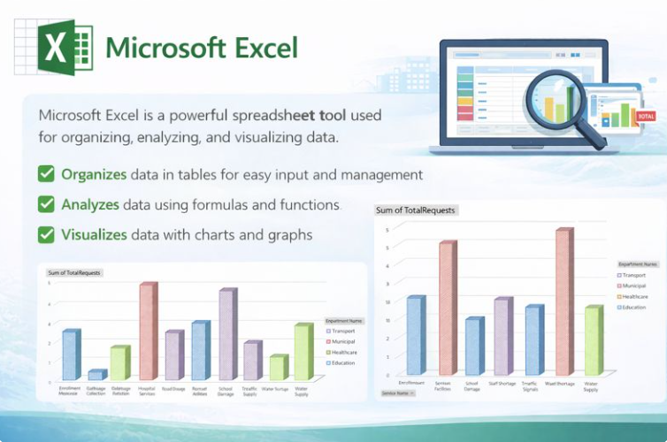
MS Excel:
We used Excel for our data visualization and data formatting.
All the data stored in the database is exported into excel, where we apply different formulas and integrated different charts so that the data can be visualize and we can see the overview of the results.

Slide 8
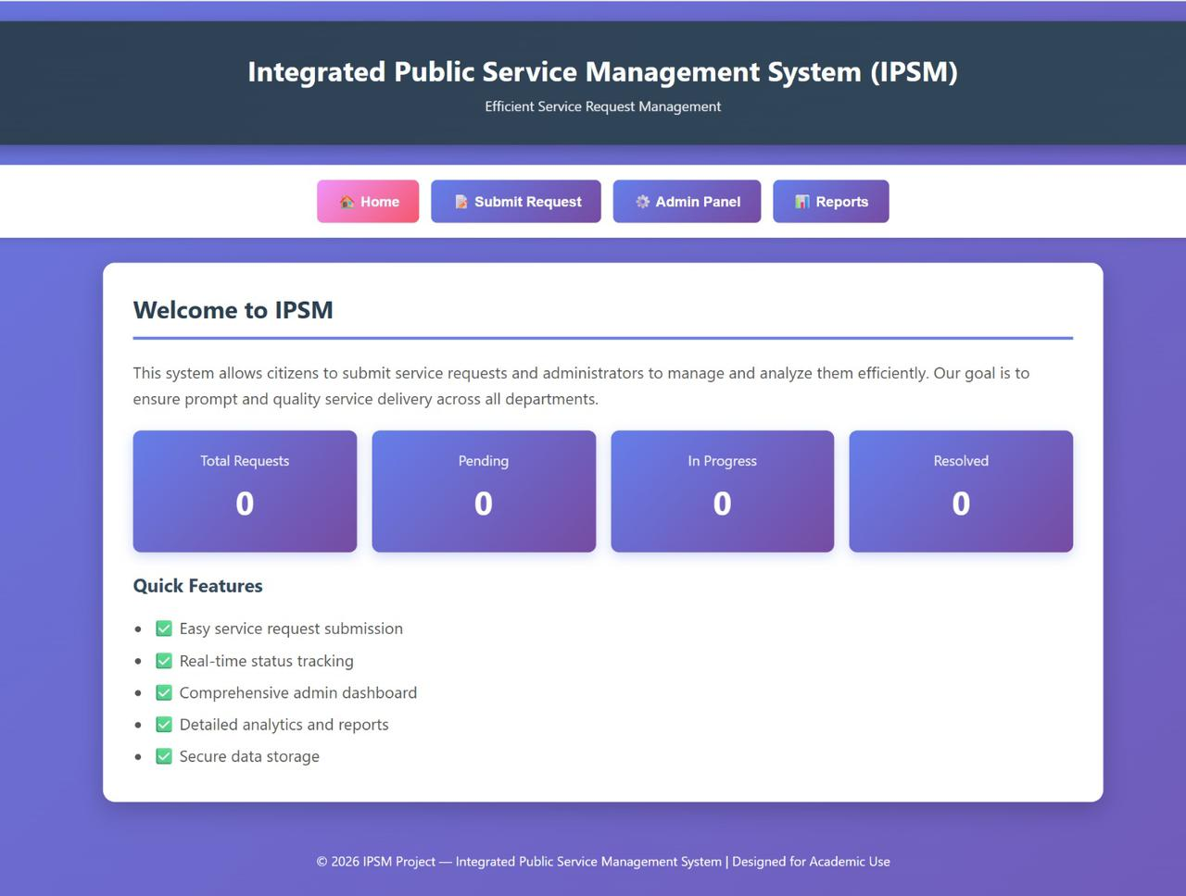
HTML For Frontend Homepage:
The user navigates to the homepage of our system, where they can see multiple departments and requested associated to each department.

Slide 9
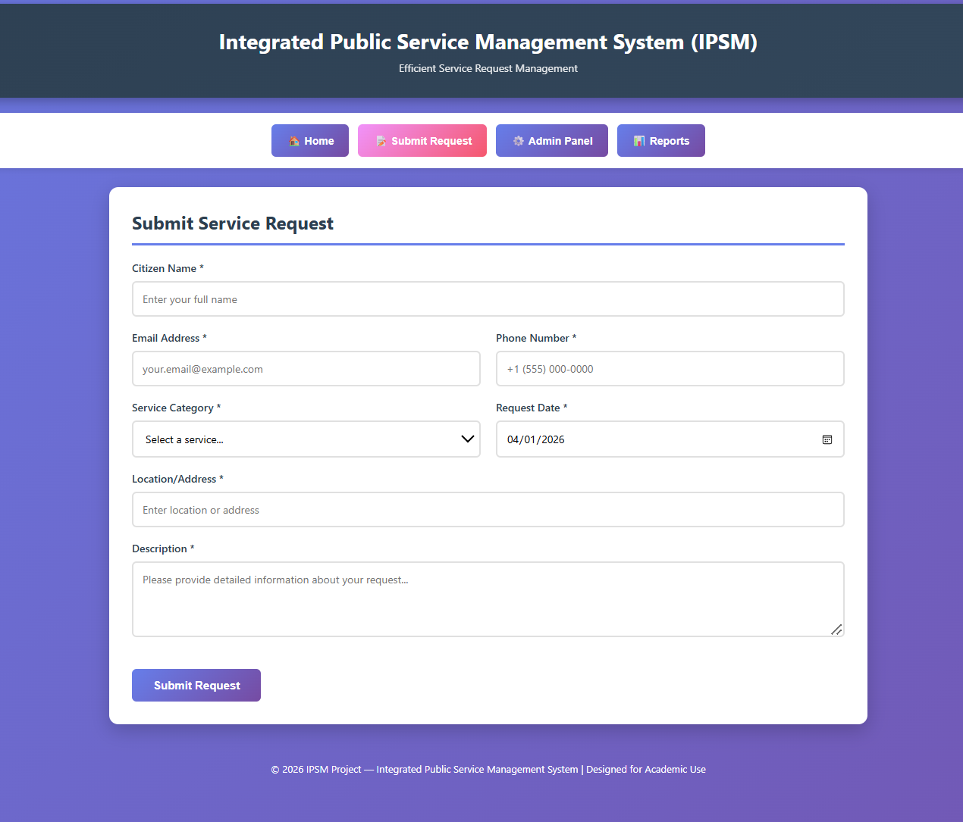
Submit Requests
The user navigates to the submit request tab, to submit the request.
This section prompt the user to fill in some details about their request and also mention the department to whom they are submitting the request.

Slide 10
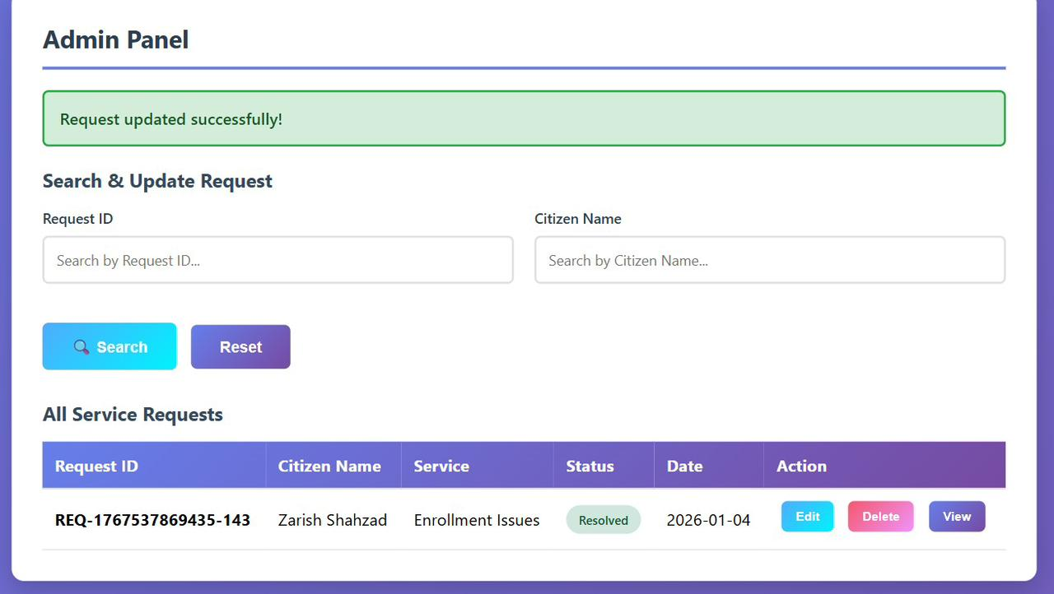
Admin Panel
Upon updating the status of data into the form, the admin can submit it, and a confirmation message would appear on the screen.

Slide 11



PowerPoint
The presentation about our project is build using PowerPoint.
The presentation includes an overall view of our project and the tools we used in our project.
MS Word:
MS Word is used to format a detailed report about our project.
It includes working of all the modules that we build along with their detail description on how each module works
GitHub:
We have used GitHub as our central repository to store and manage our both frontend and backend code.
It allowed us to view and update the code in real-time and help our team to work on it simultaneously.

Slide 12


